Slide 1
introduction
Child labour is the exploitation of children through any form of work that interferes with their ability to attend regular school, or is mentally, physically, socially and morally harmful.^{[3]} Such exploitation is prohibited by legislation worldwide,^{[4][5]} although these laws do not consider all work by children as child labourChild labour. has existed to varying extents throughout history. During the 19th and early 20th centuries, many children aged 5–14 from poorer families worked in Western nations and their colonies alike. These children mainly worked in agriculture, home-based assembly operations, factories, mining, and services such as news boys—some worked night shifts lasting 12 hours. With the rise of household income, availability of schools and passage of child labour laws, the incidence rates of child labour fell.^{[9][10][11]}

Slide 2

Preindustrial societies
Child labour forms an intrinsic part of pre-industrial economies.^{[19][20]} In pre-industrial societies, there is rarely a concept of childhood in the modern sense. Children often begin to actively participate in activities such as child rearing, hunting and farming as soon as they are competent. In many societies, children as young as 13 are seen as adults and engage in the same activities as adults

Slide 3
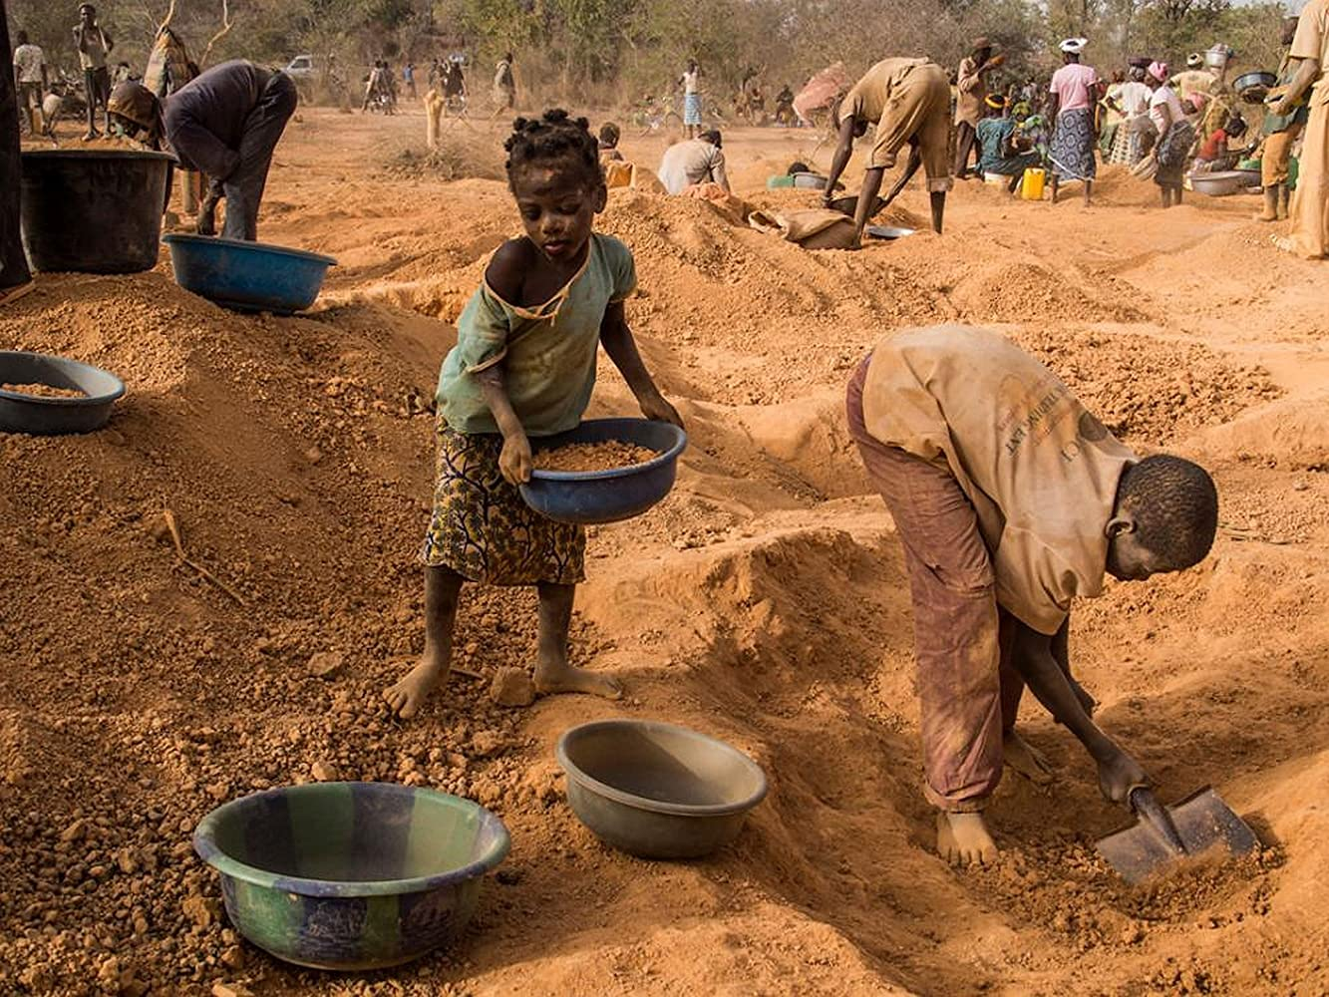
What is child labor
Child labour refers to work that children are too young to perform or that – by its nature or circumstances – can be hazardous. Unlike activities that help children develop (such as contributing to light housework or taking on a job during school holidays), child labour causes harm to a child’s health, safety or moral development.
This Photo by Unknown Author is licensed under CC BY-SA-NC

Slide 4
What kind of work is considered hazardous?
Hazardous work refers to work that, by its nature or circumstances, is likely to harm children’s health, safety or moral development.
This includes anything that exposes children to physical, emotional or sexual abuse.
It’s work that occurs underground, underwater, at treacherous heights or in confined spaces – often with dangerous machinery, equipme
nt and tools. It’s work in an unhealthy environment, where children may be exposed to hazardous substances or processes, or to extreme temperatures or noise levels. And it’s work under particularly difficult conditions, like labouring long hours or overnight.

Slide 5
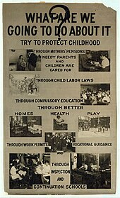
Punishments for Violating Child Labour Laws
Fines and imprisonment
Cancellation of business license
Rehabilitation support for rescued children

Slide 6
Challenges in Implementation
Poverty and lack of awareness
Weak enforcement in rural areas
Informal sectors and hidden labour

Slide 7

Child labor day

